Slide 1
Various cases and their workflow

Slide 2
Case 1
Vdj annotation, i.e filtered contig annotation (given)
+
Filtered feature bc matrix(given)
Eg -GSE158038
filter
normalize
calculate log values
highly variable genes
pca
chain qc
calculate neighbors
umap
clusters - leiden
Visualization
DGE
GSEA
Downstream analysis

Slide 3
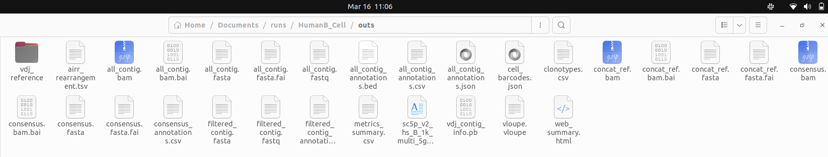
Case 2
Fastq seq ( given ; has to be of 10x genomics only)
Eg-human b cells ,1k
Cell ranger vdj pipeline (input - fastq and ref vdj annotation)
Filtered contig annotation
Filtered contig annotation
gene expression-
feature/cell matrix (given )
+
Also can visualize clonotypes using loupe vdj browser (input - vloupe.vloupe )
Downstream analysis

Slide 4
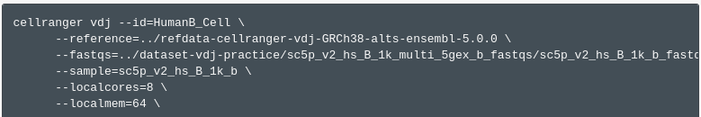
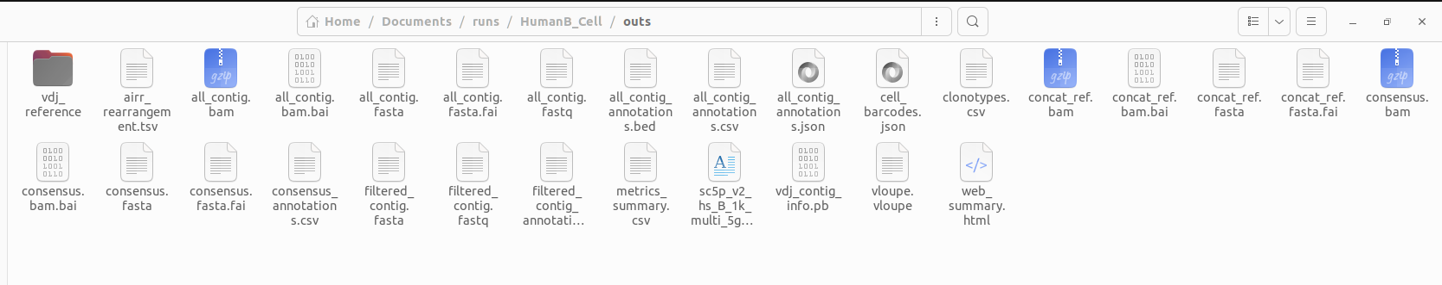
Cell ranger vdj pipeline command line
Output

Slide 5
Case 3
Fasta seq ( given,non 10x)
pyIR ; igblast algorithm (input - fasta)
Filtered contig annotation (without cell_id column, i.e the barcode, which is available in the input fasta ; AIRR format)
Filtered contig annotation
gene expression-
feature/cell matrix (given )
+
Downstream analysis

Slide 6
Case 4
Fastqs (given, from 10x dataset only)
Fastqs(given, 10x)
Cell ranger vdj pipeline
Cell ranger count pipeline
Filtered contig annotation
Feature barcode matrix
Downstream analysis

Slide 7
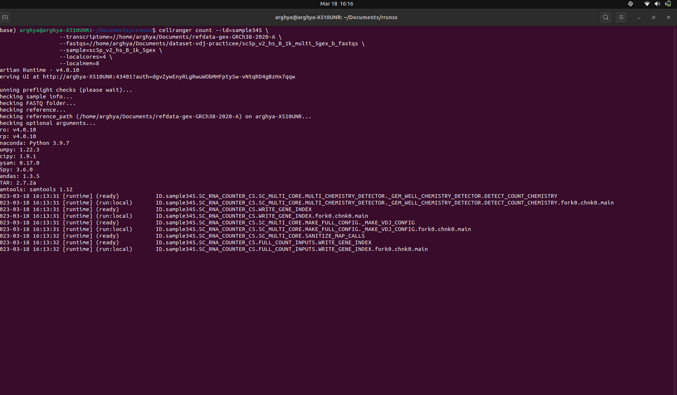

Slide 8
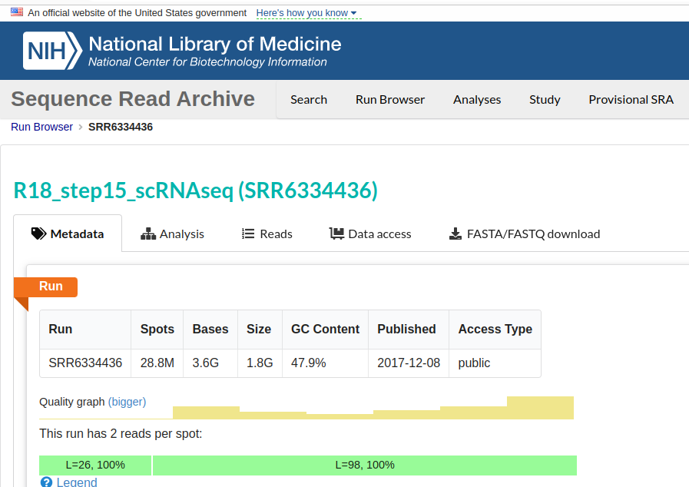
Case 5
SRA
(Needs to have at least 2-4 reads per spot & seq lib - 10x/illumina)
Fastq dump (this will give you R1,R2 and I1/I2(optional) for each read)
input - fastq /fasta
Rename the files according to 10x naming convention
Cell ranger vdj pipeline command (input - r1 and r2)
Filtered contig annotation
Cell ranger count pipeline
Feature barcode matrix
Each data represents one sample
Downstream Analysis

Slide 9
Case 6
Fasta seq -R1 and R2 (non 10x)
If sequenced by vdj library
Fastqc - to check for the length of each of the read produced by fastq dump and analyze the barcode file and the cDNA seq file
miXCR pipeline (there are 2 options, either run mixcr analyze which is a one step for all or run it step by step) input - fastq and preset
Now, on starsolo give the r1 and r2 and whitelist barcode as input.run the pipeline. ALso create a genome index
Immune receptor annotation
Genes.tsv, barcode.tsv and matrix.mtx. We are getting the count matrix /feature bc matrix
Merged

Slide 10
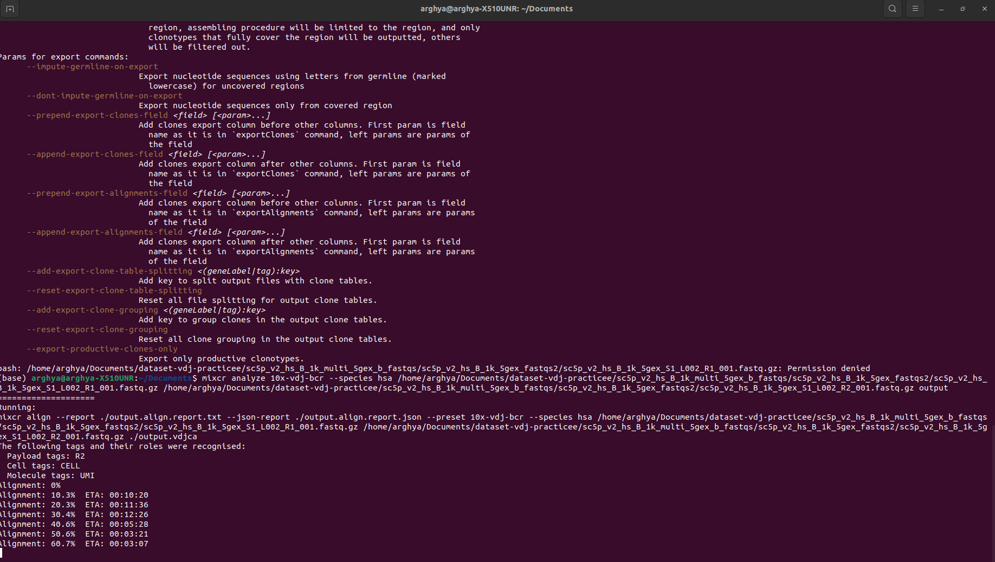
Mixcr command line

Slide 11
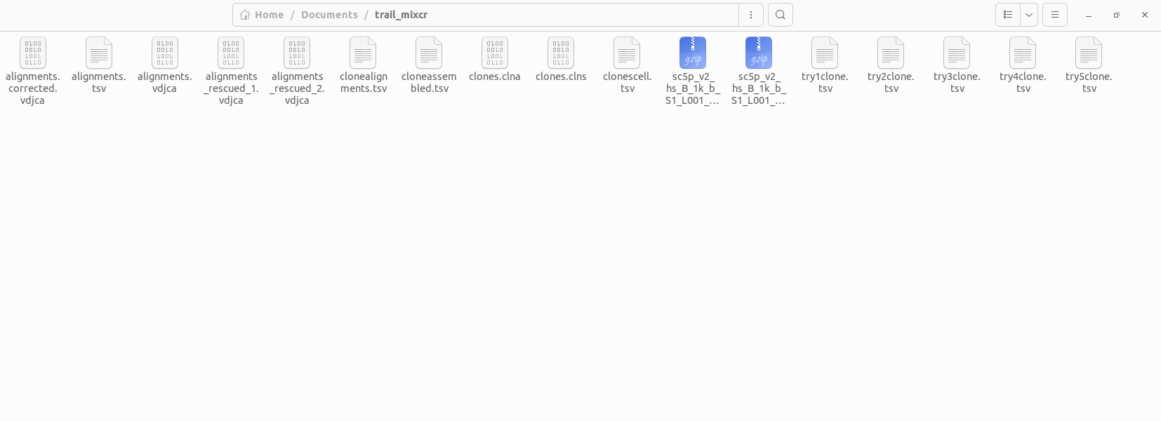
miXCR output (convert to AIRR )

Slide 12
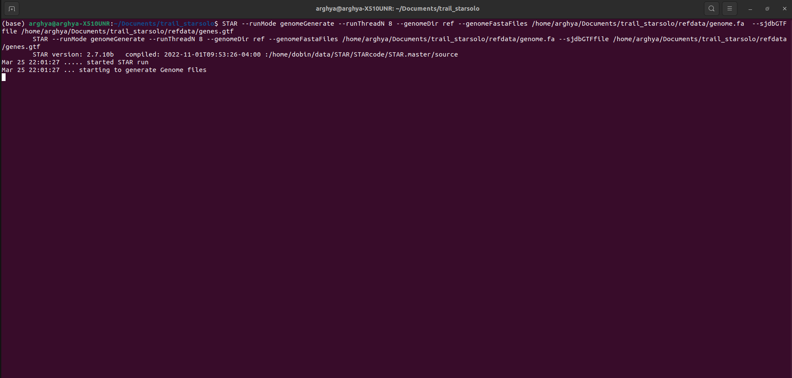
Star Solo command line

Slide 13
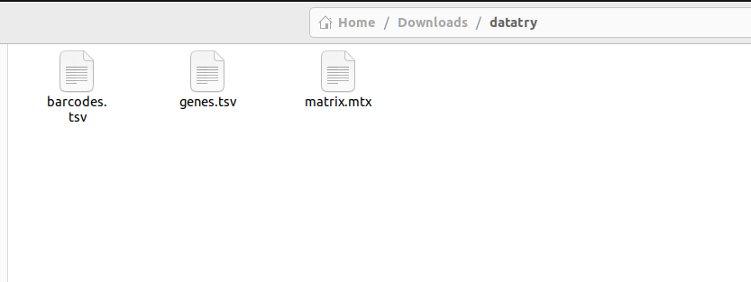
Star solo output

Slide 14
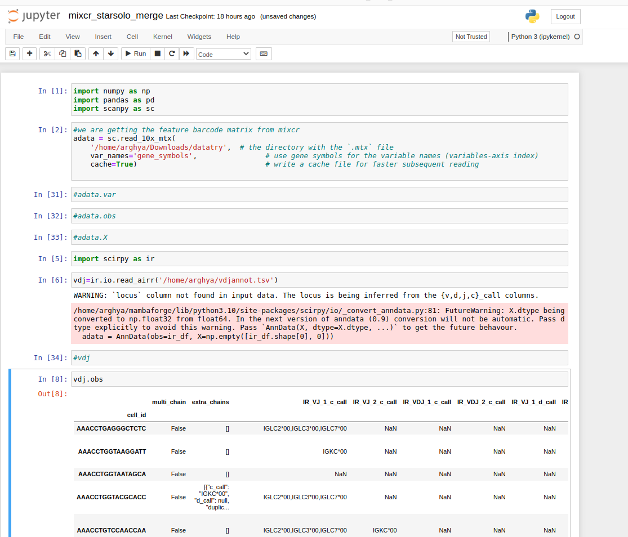
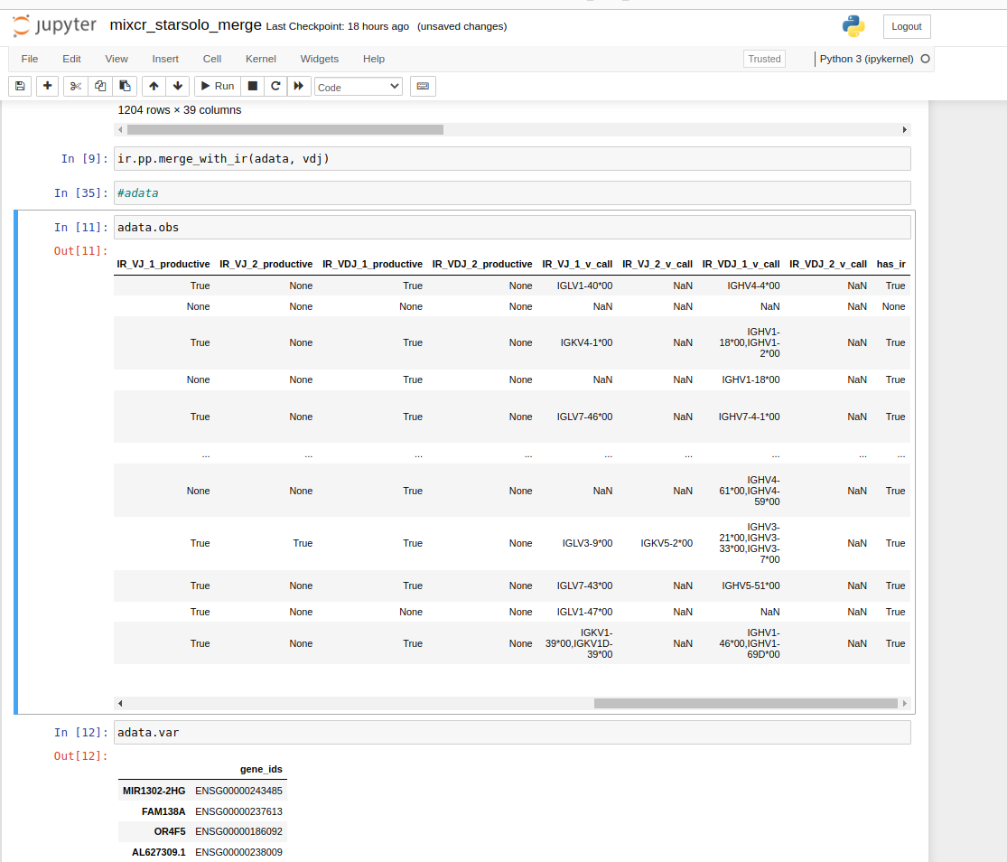
Creating anndata from mixcr and star solo output for data analysis

Slide 15
Fastq (R1 and R2 of the same Index) sequenced by vdj library, however with either 5’ and 3’ end sequencing the workflow remains the same
10x
Non-10x
StarSolo - gene expression count matrix
AND
miXCR -
Immune receptor data
Cell ranger count pipeline - Gene expression matrix
AND
Cell ranger vdj pipeline -
Immune receptor data
Next, we merge gene expression and immune receptor to get the adata and perform downstream analysis to infer insights

Slide 16
Next goal,
Trying to do automatic cell type annotation after clustering.
Improvising on immune receptor specific downstream analysis
Automate /scalable the process- one command thing - docker (job)
bash/python script

